Slide 1
Lecture-41
Numerical Problems
&
Course Review​
Course Instructor
Dr. Avinash Kumar Agarwal
Professor
Department of Mechanical Engineering
Indian Institute of Technology Kanpur, Kanpur

Slide 2
Learning Objectives
Numerical Problems
Course Review

Slide 3
Numerical Problems

Slide 4
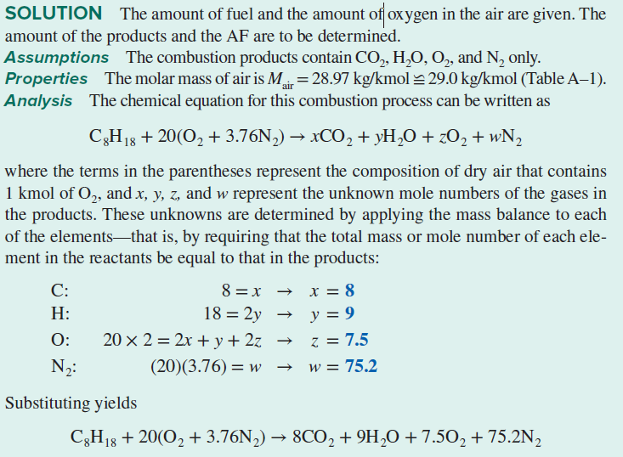
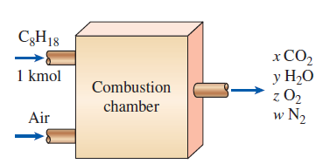
Question 1: One kmol of octane (C₈H₁₈) is burned with air that contains 20 kmol of O2, as shown in Figure. Assuming the products contain only CO2, H2O, O2, and N2, determine the mole number of each gas in the products and the air–fuel ratio for this combustion process.

Slide 5
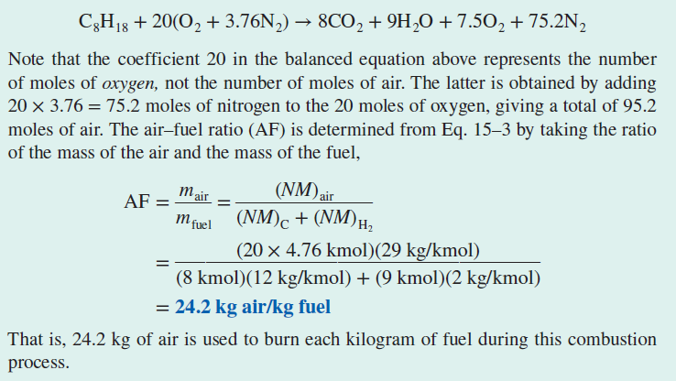

Slide 6
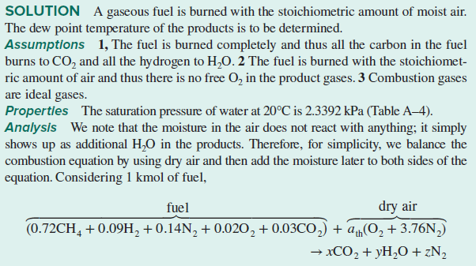
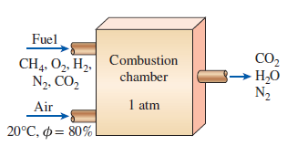
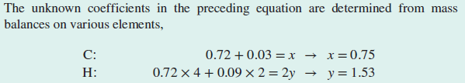
Question 2: A certain natural gas has the following volumetric analysis: 72 percent CH4, 9 percent H2, 14 percent N2, 2 percent O2, and 3 percent CO2. This gas is now burned with the stoichiometric amount of air that enters the combustion chamber at 20°C, 1 atm, and 80 percent relative humidity, as shown in Figure. Assuming complete combustion and a total pressure of 1 atm, determine the dew-point temperature of the products.

Slide 7
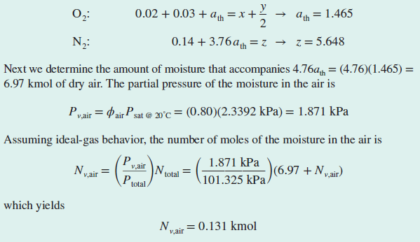

Slide 8
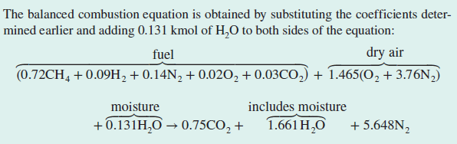
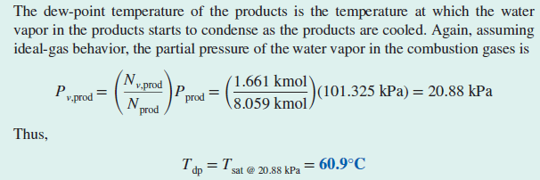

Slide 9
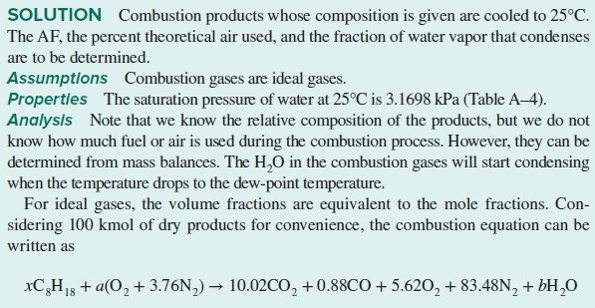
Question 3: Octane (C₈H₁₈) is burned with dry air. The volumetric analysis of the products on a
dry basis is figure
CO2 : 10.02 percent
O2 : 5.62 percent
CO : 0.88 percent
N2 : 83.48 percent
Determine (a) the air–fuel ratio, (b) the percentage of theoretical air used, and (c) the amount of H2O that condenses as the products are cooled to 25°C at 100 kPa.

Slide 10
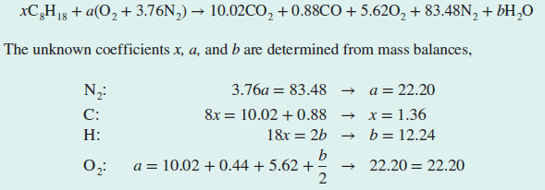
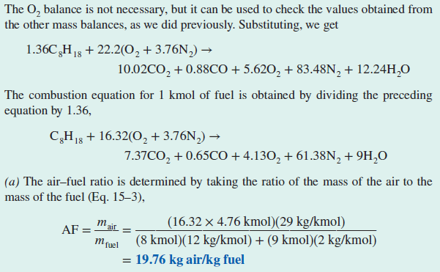

Slide 11
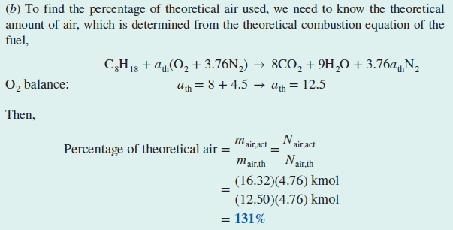
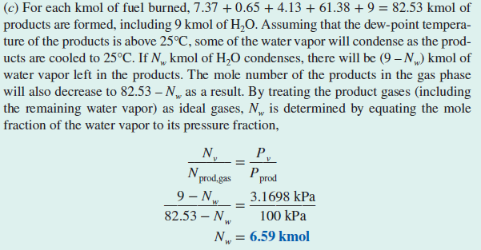

Slide 12
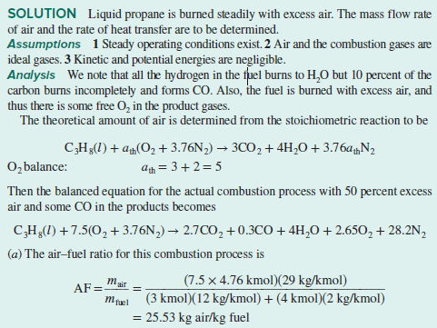
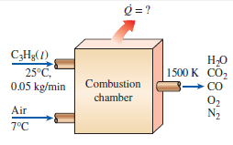

Questions 4: Liquid propane (C₃H₈) enters a combustion chamber at 25°C at a rate of 0.05 kg/min where it is mixed and burned with 50 percent excess air that enters the combustion chamber at 7°C, as shown in Figure. An analysis of the combustion gases reveals that all the hydrogen in the fuel burns to H₂O but only 90 percent of the carbon burns to CO₂, with the remaining 10 percent forming CO. If the exit temperature of the combustion gases is 1500 K, determine (a) the mass flow rate of air and (b) the rate of heat transfer from the combustion chamber.

Slide 13
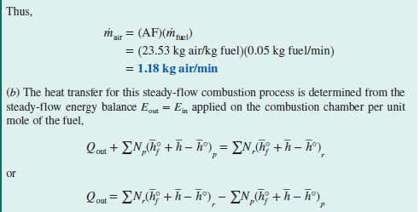
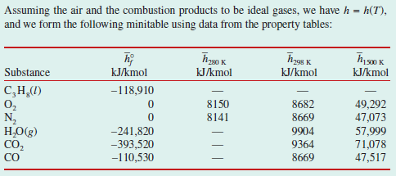

Slide 14
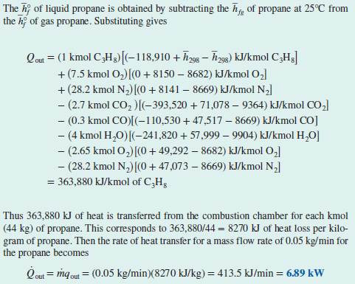

Slide 15
Thanks

